Slide 1



Publish your data
HADC! (HARPER ADAMS DATA CLUB)
Ed Harris
2025-10-28

Slide 2

Do people actually publish their data?
TRANSPARENCY AND REPRODUCIBILITY
SHARING DATA ALLOWS OTHERS TO VERIFY FINDINGS, REPRODUCE ANALYSES, AND BUILD CONFIDENCE IN THE RESEARCH.
INCREASED VISIBILITY AND IMPACT
PUBLISHED DATASETS CAN BE CITED, ATTRACTING RECOGNITION AND BOOSTING THE REACH OF A RESEARCHER’S WORK.
COLLABORATION AND REUSE
OPEN DATA SUPPORTS NEW DISCOVERIES BY ENABLING OTHERS TO COMBINE, REPURPOSE, OR EXTEND EXISTING DATASETS FOR FURTHER RESEARCH.
Yep! This is popular and has become an element of best practice

Slide 3






Do people actually publish their data?
OPERATED BY CERN AND OPENAIRE. SUPPORTS DATASETS, SOFTWARE, AND PUBLICATIONS. PROVIDES DOI AND SUPPORTS GITHUB INTEGRATION.
Where do people publish datasets?
(there are many options)
COMMERCIAL SERVICE WIDELY USED BY UNIVERSITIES. PROVIDES DOI, VISUAL PREVIEWS, AND ANALYTICS.
CURATED REPOSITORY FOR RESEARCH DATA UNDERLYING PUBLICATIONS. OFTEN JOURNAL-INTEGRATED.
OPEN-SOURCE DATAVERSE REPOSITORY USED GLOBALLY. SUPPORTS METADATA-RICH DATASETS AND DOI.

Slide 4
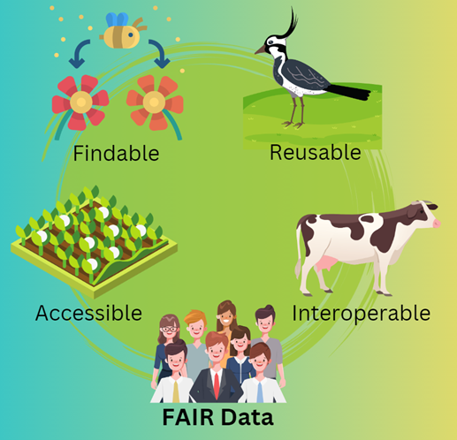
Have you heard of
FAIR data?
WILKINSON, M. D., ET AL. (2016). THE FAIR GUIDING PRINCIPLES FOR SCIENTIFIC DATA MANAGEMENT AND STEWARDSHIP. SCIENTIFIC DATA, 3, 160018.

Slide 5
FAIR data principles
FINDABLE: DATA SHOULD BE EASY TO DISCOVER THROUGH CLEAR METADATA AND PERSISTENT IDENTIFIERS.
ACCESSIBLE: ONCE FOUND, DATA SHOULD BE RETRIEVABLE USING STANDARDIZED PROTOCOLS.
INTEROPERABLE: DATA SHOULD USE COMMON FORMATS AND VOCABULARIES TO ALLOW INTEGRATION WITH OTHER DATASETS.
REUSABLE: DATA SHOULD BE WELL-DESCRIBED AND LICENSED TO ENABLE REUSE IN VARIOUS CONTEXTS.
WILKINSON, M. D., ET AL. (2016). THE FAIR GUIDING PRINCIPLES FOR SCIENTIFIC DATA MANAGEMENT AND STEWARDSHIP. SCIENTIFIC DATA, 3, 160018.

Slide 6
FAIR data principles
THESE PRINCIPLES AIM TO
ENHANCE THE ABILITY TO FIND AND USE DATA,
THUS SUPPORTING KNOWLEDGE DISCOVERY AND INNOVATION.
WILKINSON, M. D., ET AL. (2016). THE FAIR GUIDING PRINCIPLES FOR SCIENTIFIC DATA MANAGEMENT AND STEWARDSHIP. SCIENTIFIC DATA, 3, 160018.

Slide 7
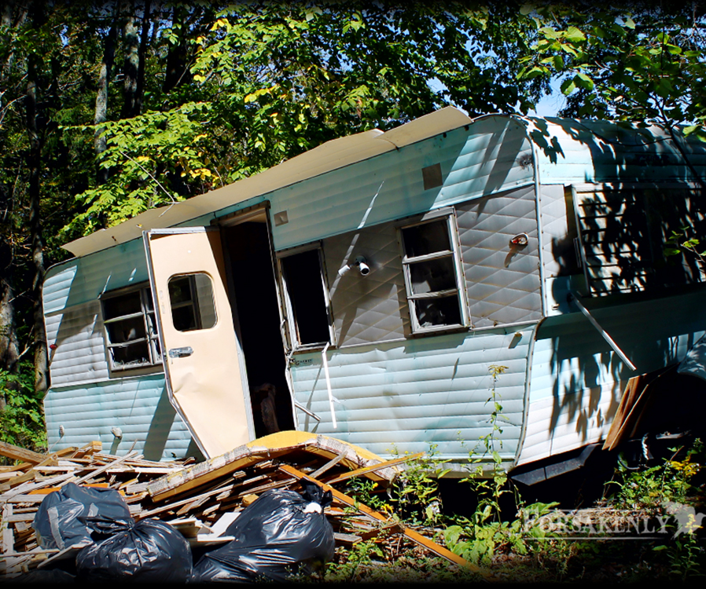

We need to talk about your data
DATA YOU HAVE
DATA YOU WANT

Slide 8
HAU Data Policy
Establishes standards for research data aligned with FAIR principles (Findable, Accessible, Interoperable, Reusable).
Applies to all research data, including the Future Farm and Long-Term Experiments.
Promotes open, ethical, and high-quality data management for transparency and collaboration.
Harris, W.E. 2025. Harper Adams University Scientific Data Policy, Harper Adams University, Edgmond, UK.

Slide 9
HAU Data Policy
Requires secure storage in the Harper Adams Dataverse with DOIs for citation and access.
Emphasises Tidy Data, strong metadata, and documentation for reusability.
Defines clear roles for researchers, students, IT, and administration to ensure compliance and stewardship.
Harris, W.E. 2025. Harper Adams University Scientific Data Policy, Harper Adams University, Edgmond, UK.

Slide 10
What is this Tidy Data of which you speak?
Each variable is a column, each observation a row
Creates clear, consistent data structure for analysis and visualisation.
Enables efficient, reproducible, and automated data workflows.
Documents variables (e.g. as in a data dictionary), sampling, experimental design and/or providence of data
Document effect size
Wickham, H., 2014. Tidy Data. Journal of Statistical Software 59, 1–23.

Slide 11
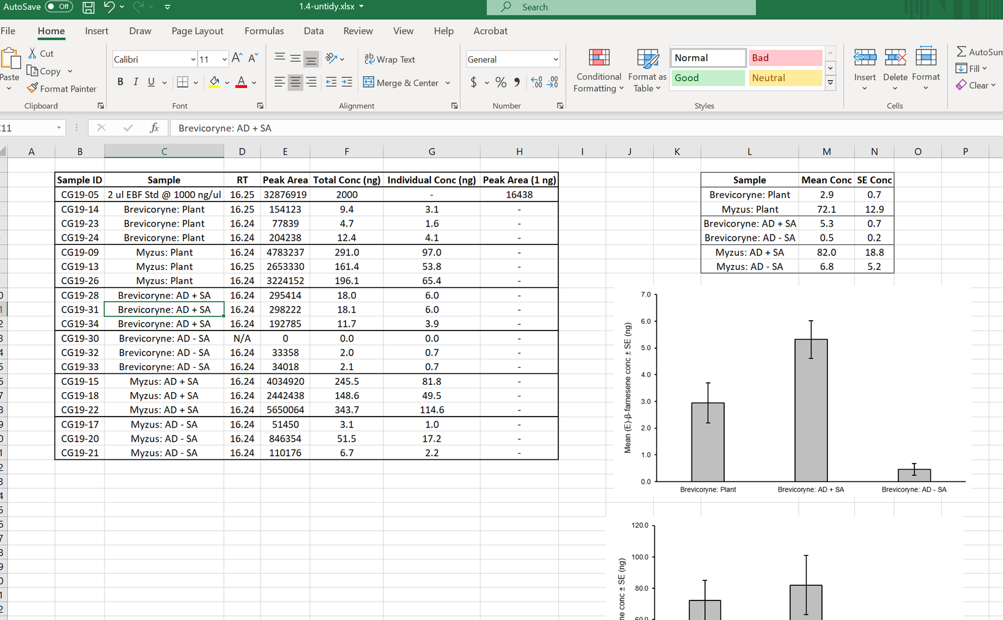
What is this Tidy Data of which you speak?
Wickham, H., 2014. Tidy Data. Journal of Statistical Software 59, 1–23.

Slide 12
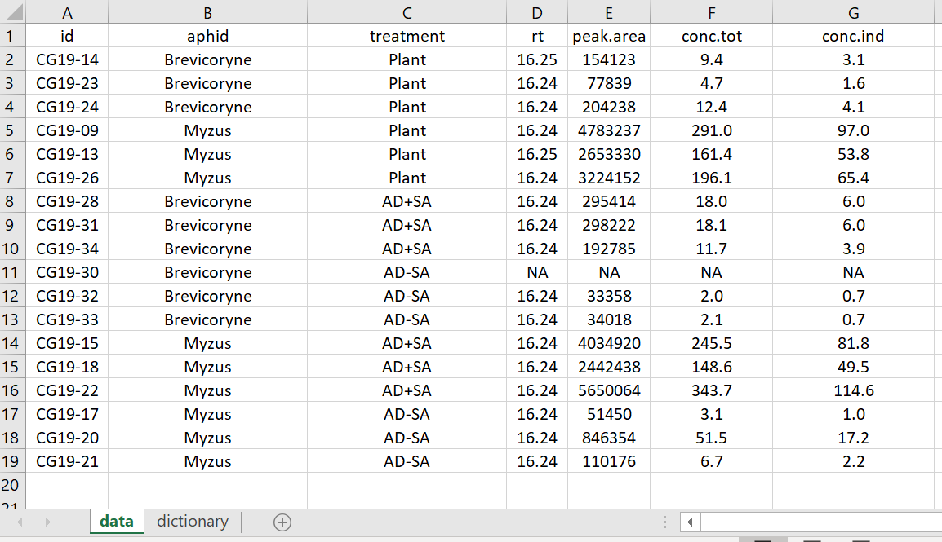
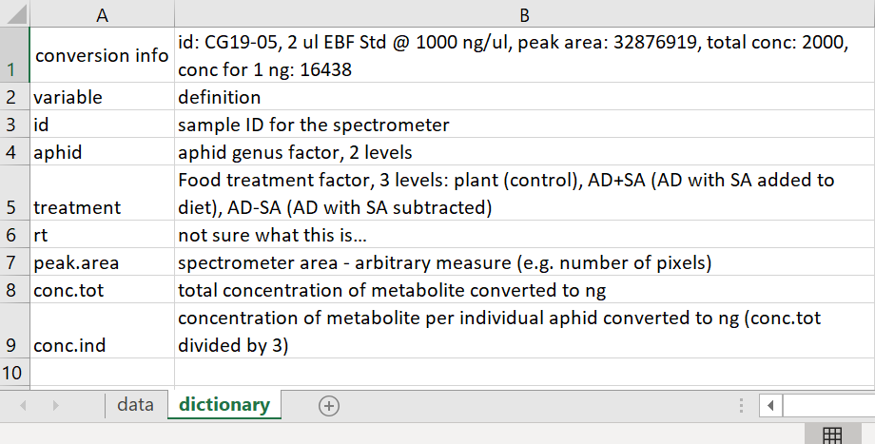
What is this Tidy Data of which you speak?
Also, need an account of the data creation or acquisition
Wickham, H., 2014. Tidy Data. Journal of Statistical Software 59, 1–23.

Slide 13
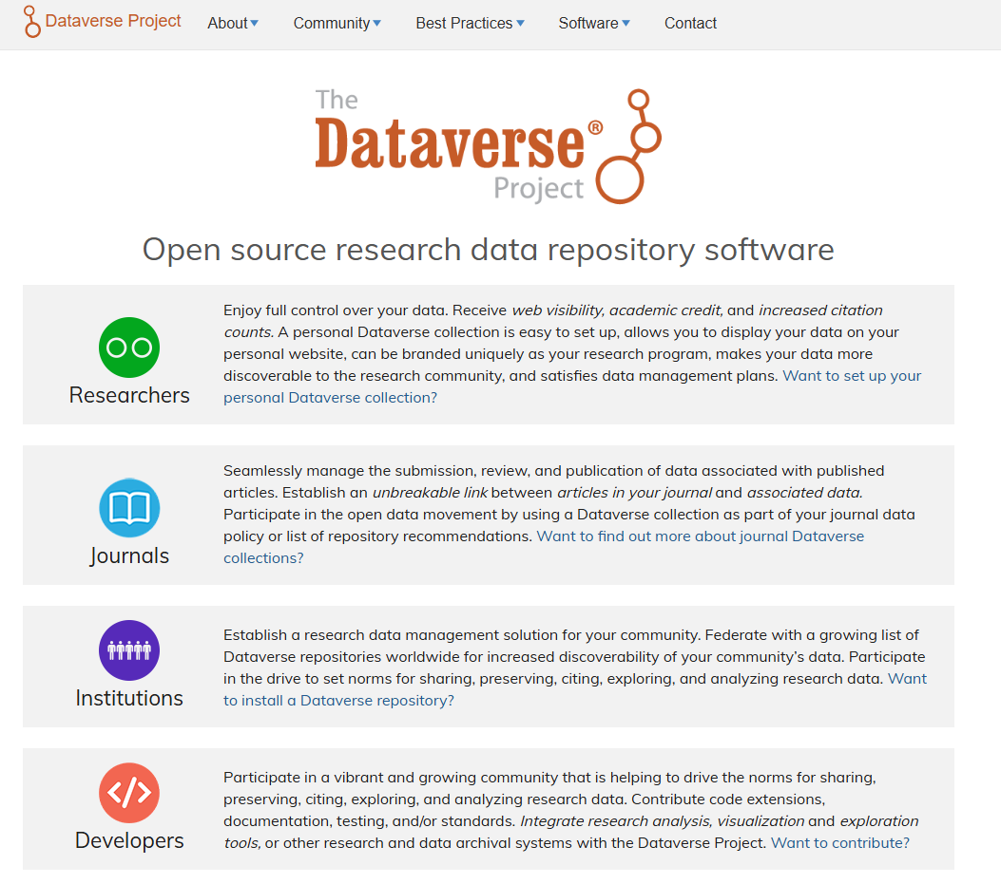

So, how can YOU publish your data?
https://dataverse.org/

Slide 14

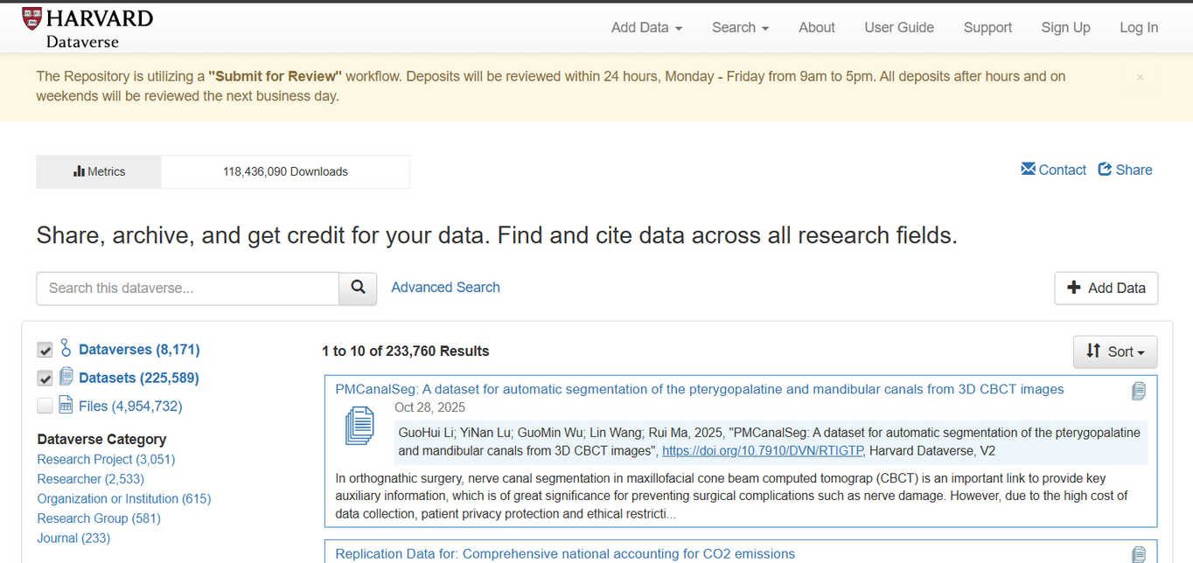
So, how can YOU publish your data?
(Data Multiverse)
https://dataverse.harvard.edu/dataverse/harvard

Slide 15
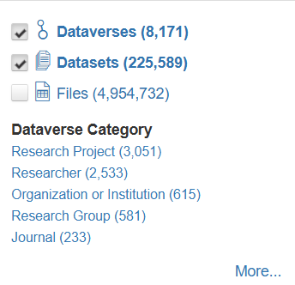
So, how can YOU publish your data?
(Data Multiverse)
https://dataverse.harvard.edu/dataverse/harvard

Slide 16

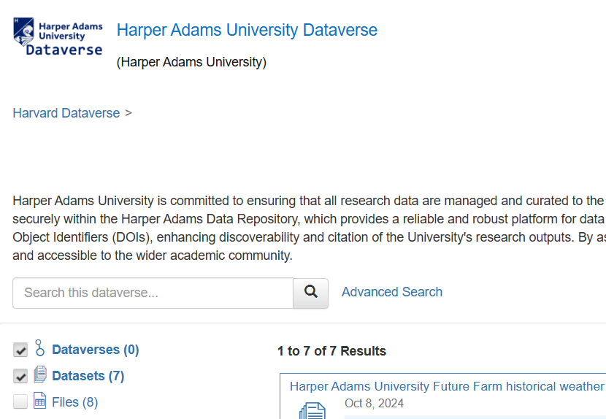
So, how can YOU publish your data?
https://dataverse.harvard.edu/dataverse/HAUDataverse/

Slide 17
So, how can YOU publish your data?
Adheres to HAU data policy
Documents data, effect size, etc. for researchers, (e.g. supervisors, designing next experiment)
Provides DOI for citations, community, cv
https://dataverse.harvard.edu/dataverse/HAUDataverse/

Slide 18

Full support to publish data
Tidy data formating and “metadata” prep
Effect size communication
DOI registration
Licencing advice
(self-service in future)
https://www.weharris.me/files/HA_Stats_Service_Policy_2025.docx

Slide 19





Full support to publish data
Contact us anytime to discuss
https://www.weharris.me/files/HA_Stats_Service_Policy_2025.docx

Slide 20
The End
HADC! (HARPER ADAMS DATA CLUB)
Ed Harris
2025-10-28

